Slide 1
ChatGPT Crash Course for Teachers
How you can use it
How your students can use it
Cautions/Considerations

Slide 2

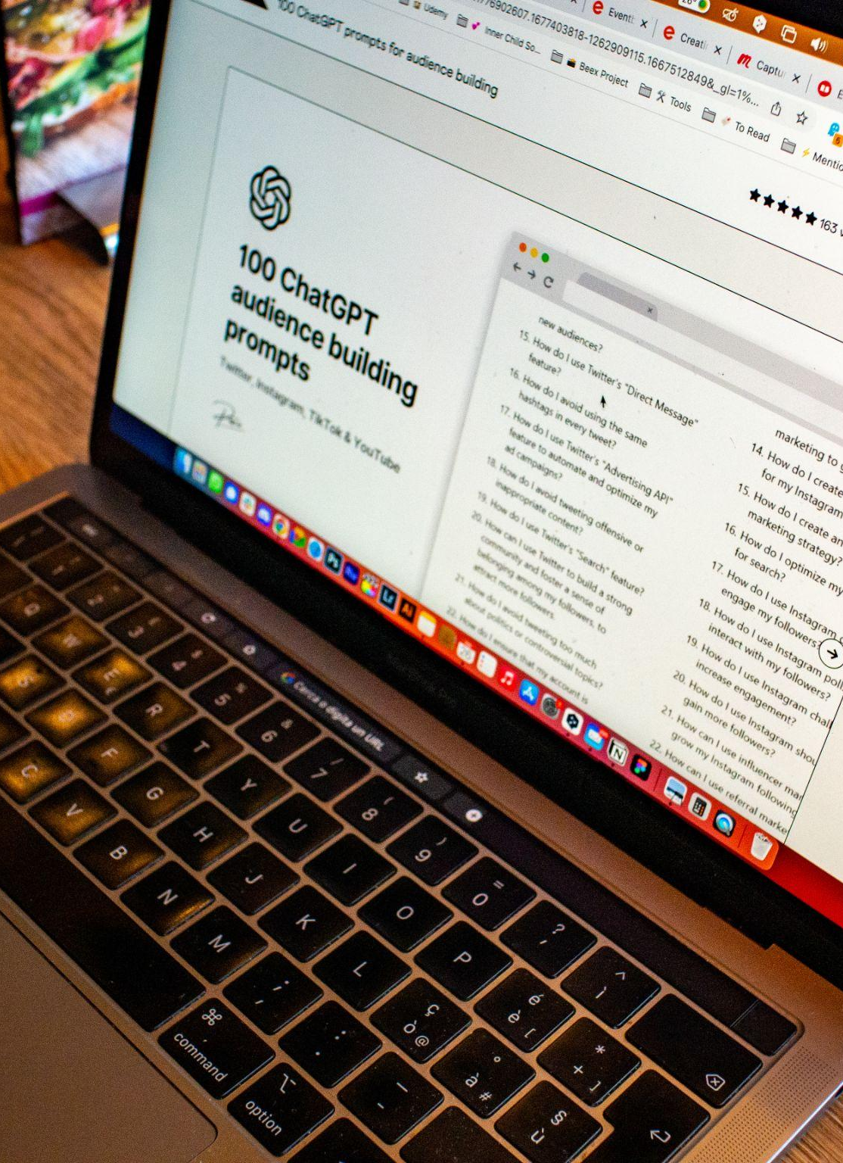
What is ChatGPT?
ChatGPT is a large language model developed by OpenAI
Developed to understand natural language and generate human-like responses to a wide range of prompts (text, voice, images…)
Has a variety of uses (language translation, content creation, and data analytics)

Slide 3

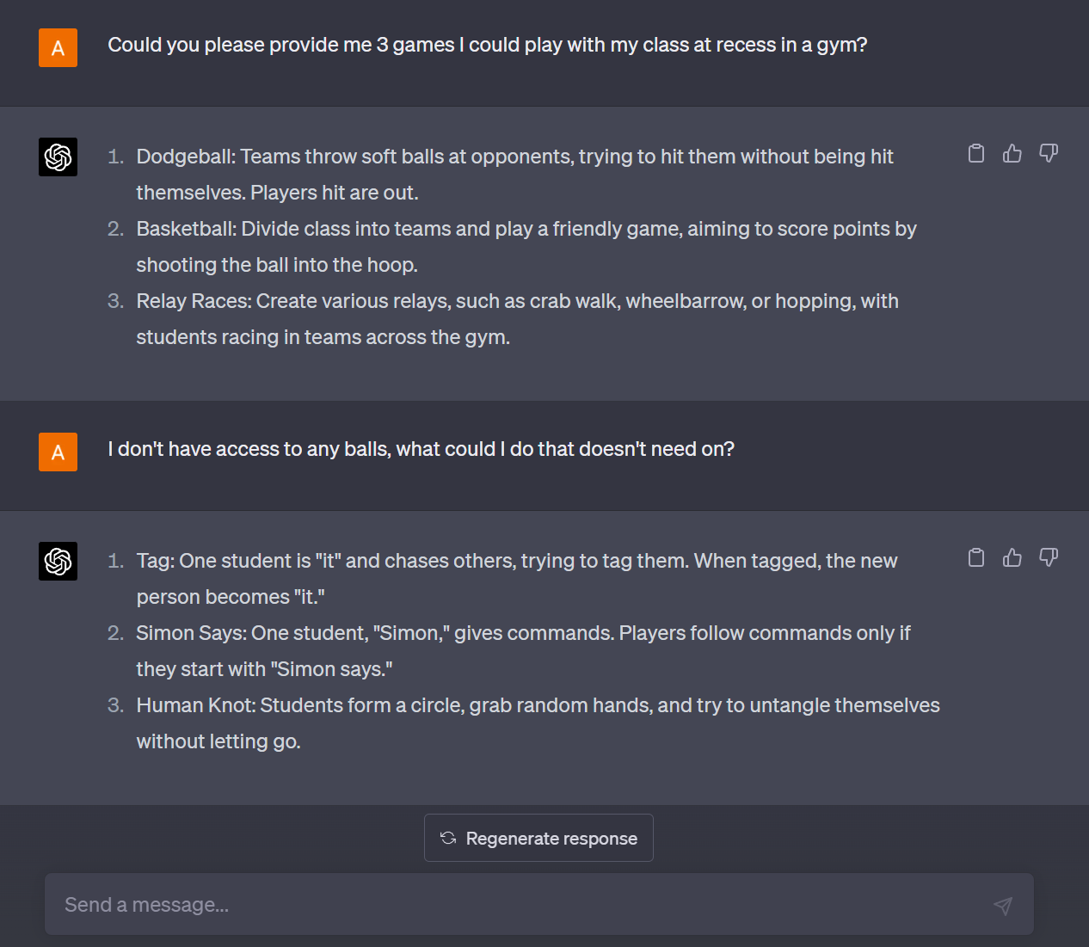
How Does it Work?
User inputs a “Prompt” which asks or tells ChatGPT what they want
ChatGPT takes the input and uses reasoning to understand what the user wants and generates an output
Remembers previous conversations so your prompts can build on one another

Slide 4
How Teachers Can Use ChatGPT

Slide 5

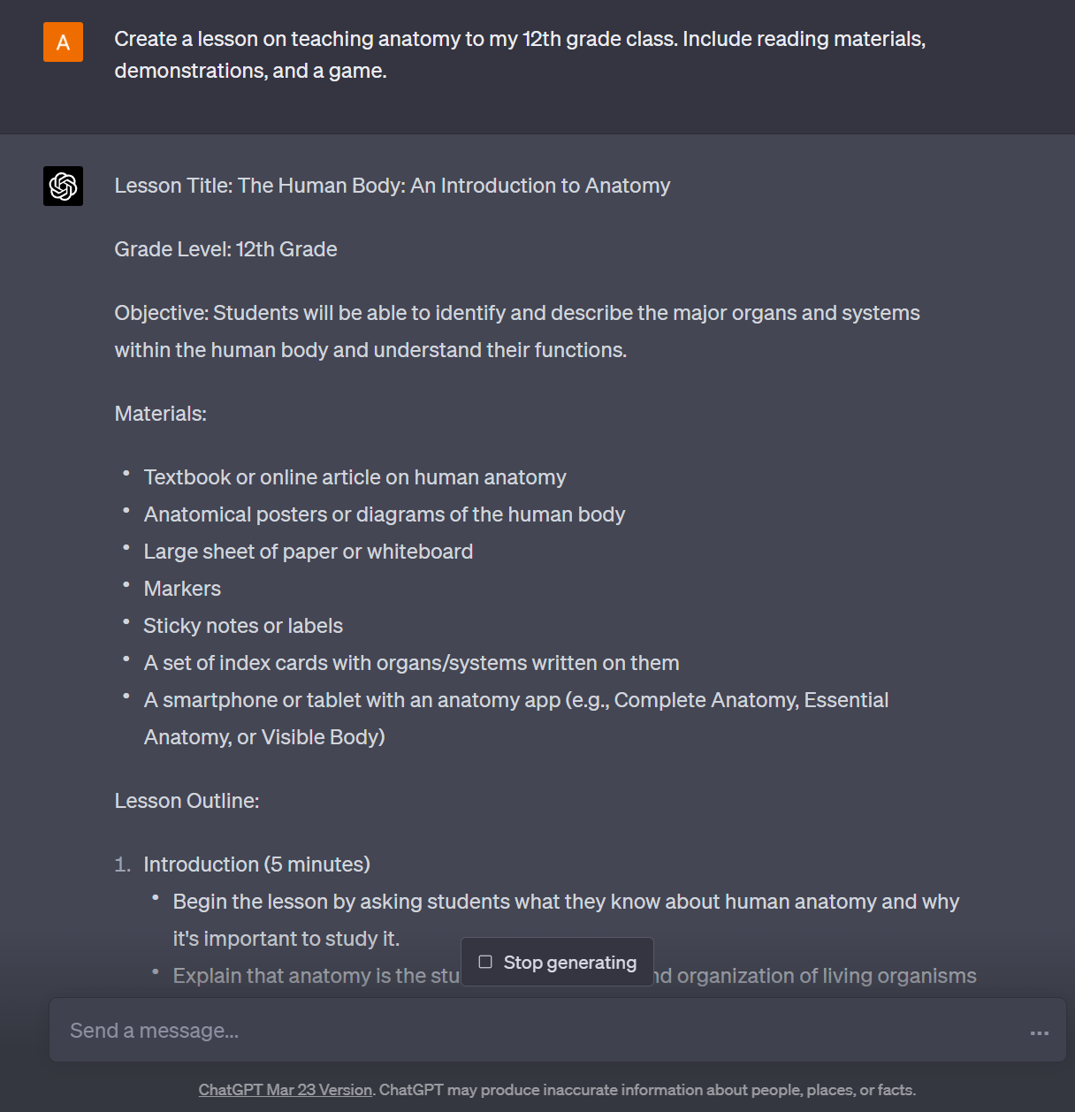
Lesson Planning
Create Outline for daily, weekly, monthly lessons
Generates outlines for specific subjects and topics
Customizing content to address individual student needs
Notes:
Be sure to tell teachers that they can use chatgpt to help integrate The Bible and Christian values into this lesson plan… this topic, etc.

Slide 6

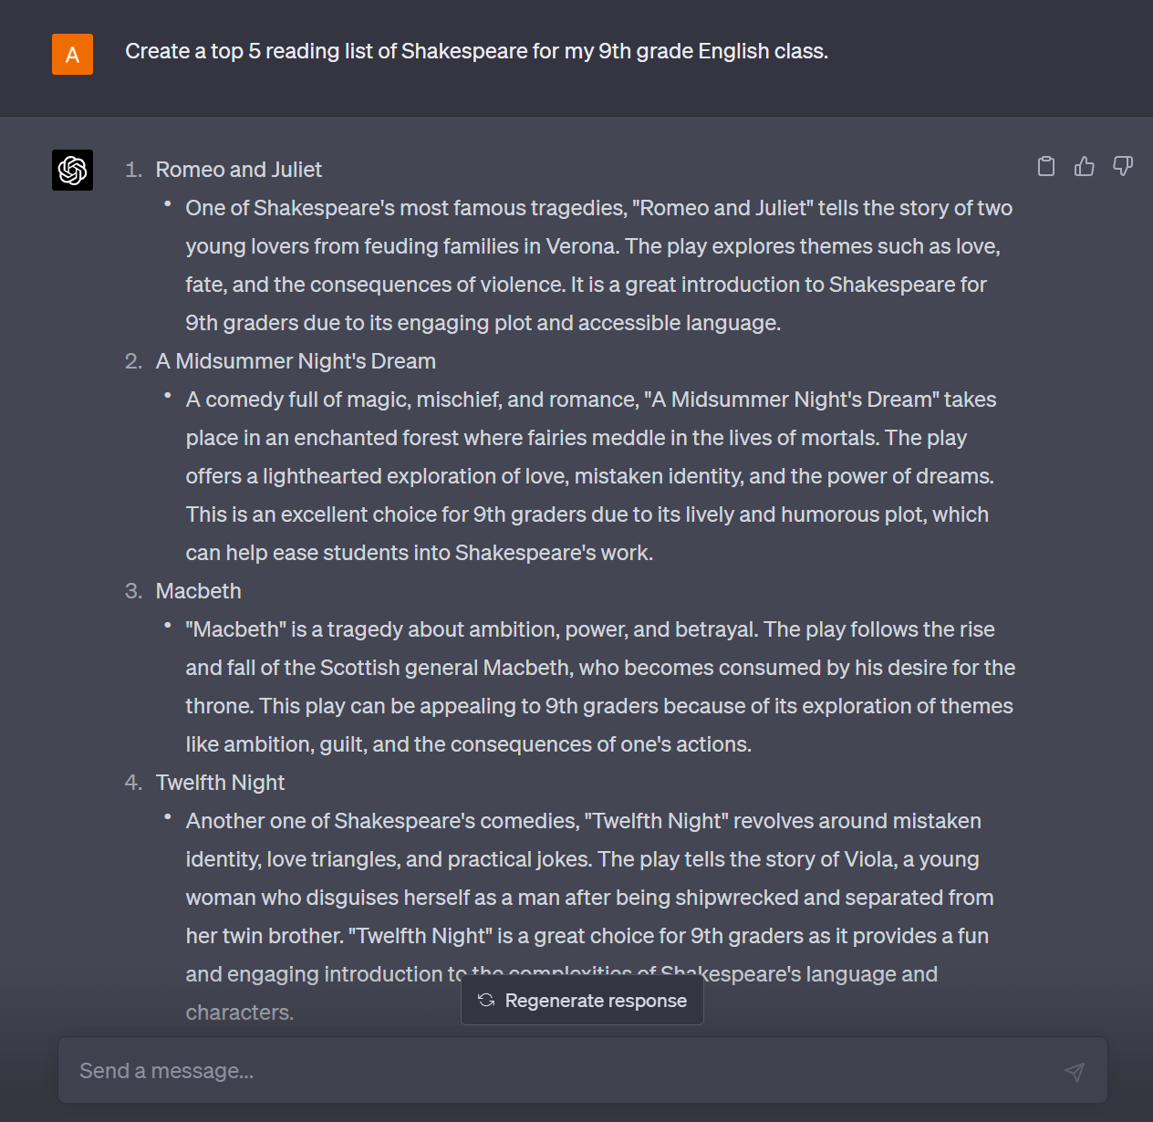
2. Content Creation
´
Creation of supplementary materials (worksheets, quizzes, etc.)
Creating reading lists, classroom activities, games, worksheets, and handouts
Can provide links and resources for specific content you need
Notes:
Explaining Code
Deciphers complex syntax: ChatGPT can help you understand unfamiliar or complicated code by providing clear explanations of code structures, functions, and logic.
Offers code optimization suggestions: ChatGPT can suggest ways to improve your code, making it more efficient, readable, and maintainable.
Explains library and API usage: ChatGPT can help you understand the purpose and usage of various libraries and APIs, helping you integrate them effectively into your data analysis workflow.
Generating Code

Slide 7
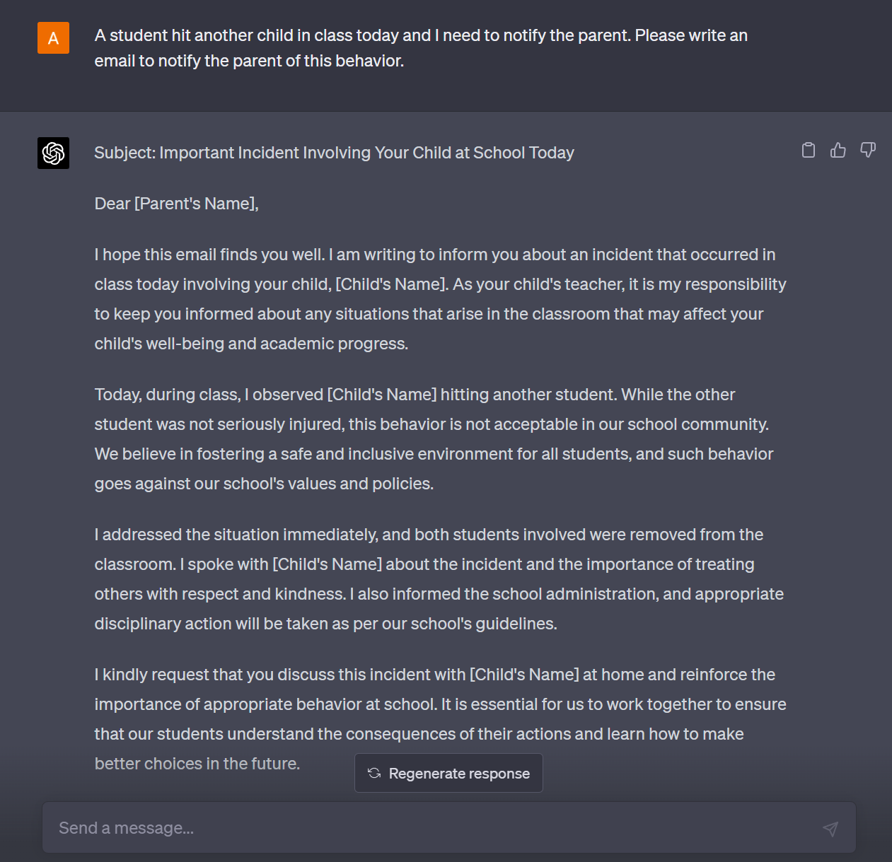
3. Create Templates
Create templates for Parent Communications: Weekly updates, Poor classroom behavior, etc. Templates for Study guide and review materials
The possibilitie sare endless!
Remember: Give follow up prompts to fine tune the output
Notes:
Provides step-by-step guidance: ChatGPT can walk you through complex data analysis techniques, breaking down concepts into smaller, digestible parts.
Offers personalized learning: ChatGPT can adapt to your current skill level, providing tailored explanations and examples to help you grasp new topics.
Suggests relevant resources: ChatGPT can recommend articles, tutorials, and courses to deepen your understanding of specific data analysis topics.
Encourages interactive learning: You can ask ChatGPT questions to clarify doubts, test your understanding, and get immediate feedback on your learning progress.

Slide 8
How Students Can Use ChatGPT

Slide 9
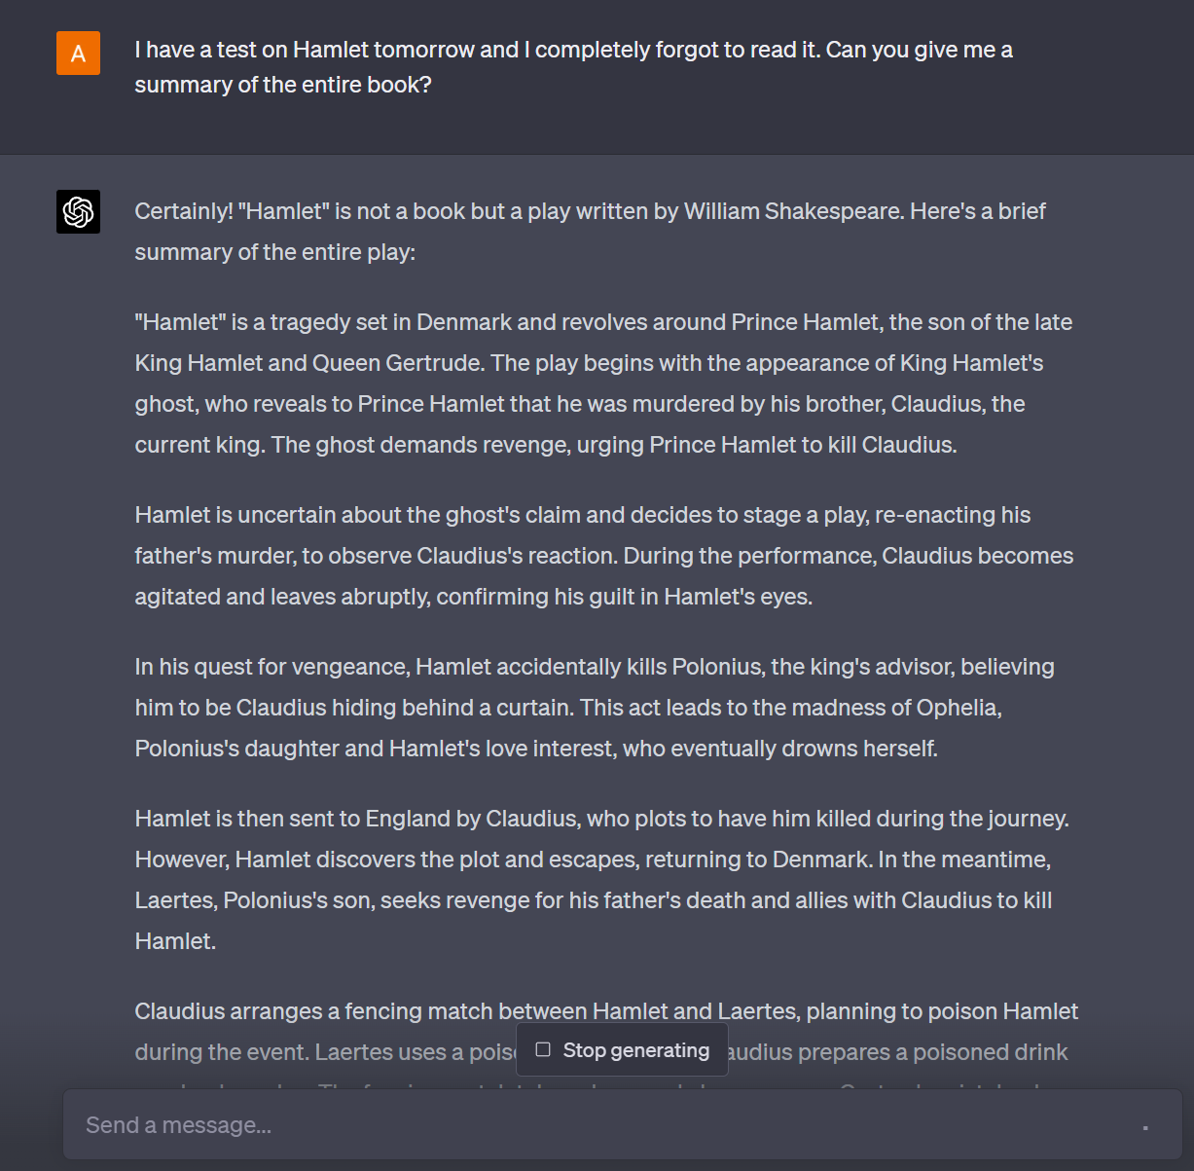
1. Research/Studying
Students can use it to summarize notes, books, lectures into easily understood points
Provides links and resources to articles and websites for specified topics
Can ask ChatGPT to create a study guide on certain subjects and topics
Notes:
Answering Domain Questions
Provides domain-specific insights: ChatGPT can answer questions about specific industries, helping you make informed decisions in your data analysis.
Clarifies terminology: ChatGPT can explain domain-specific terms and jargon, improving your understanding of the subject matter.
Offers contextual guidance: ChatGPT can provide advice on how to approach data analysis in specific domains, considering industry-specific nuances and trends.
Shares case studies and best practices: ChatGPT can provide examples of successful data analysis projects in your domain, helping you learn from real-world experiences.

Slide 10
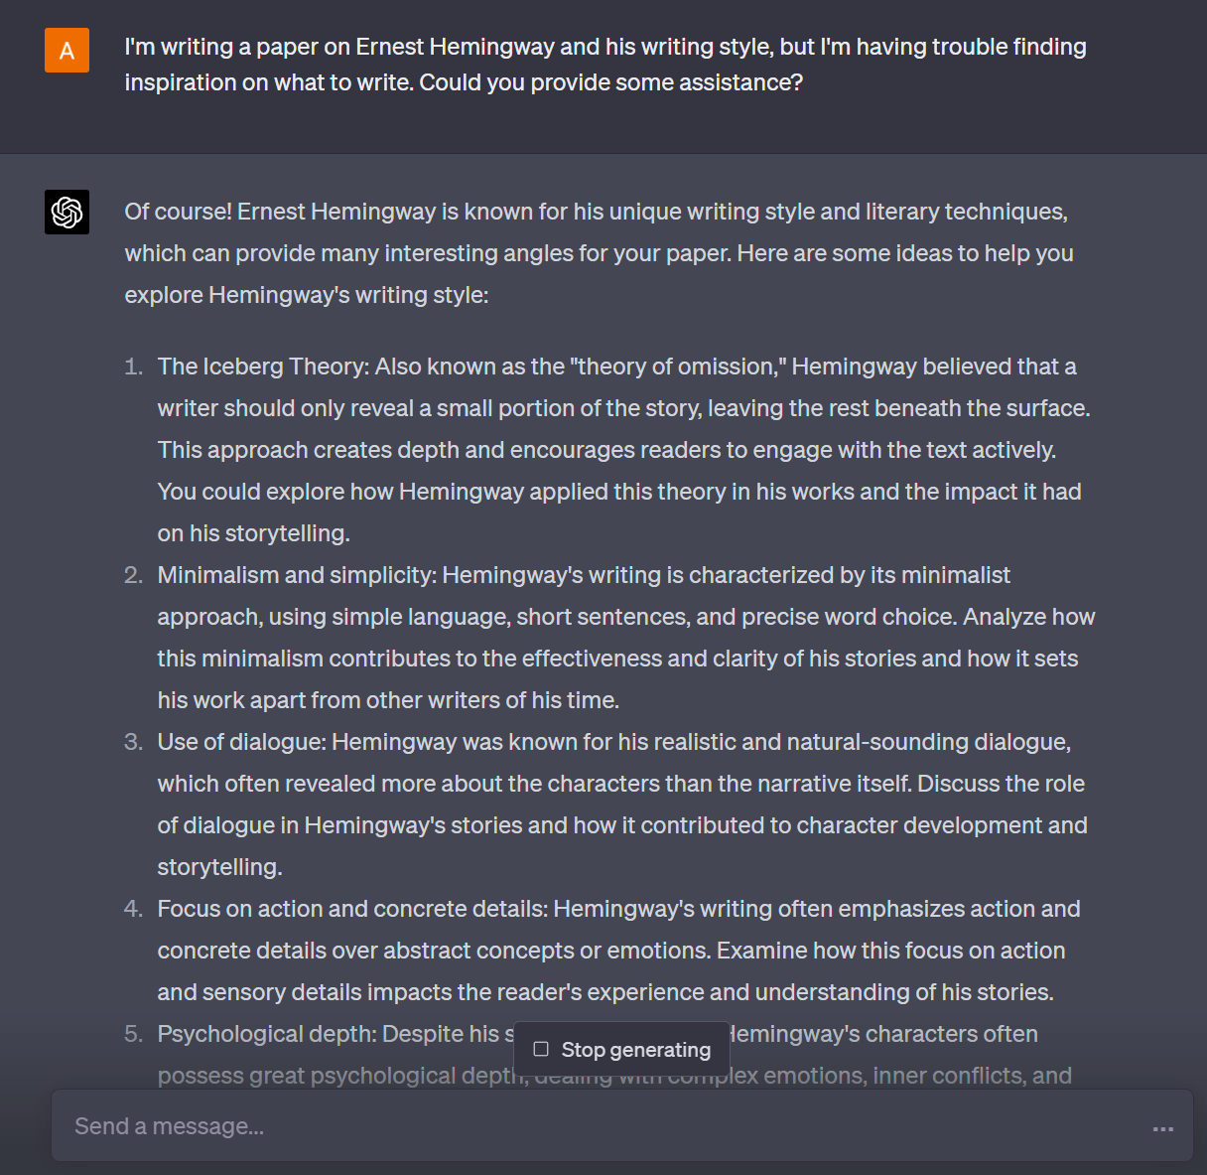

2. Writing Assistance and Editing
ChatGPT can help paraphrase or expand initial drafts of writing
It can help proofread, spellcheck, and offer suggestions on entire papers
Can outline a paper on desired topic
Notes:
Data Cleaning
Identifies data quality issues: ChatGPT can help you spot inconsistencies, missing values, and potential outliers in your data.
Suggests data cleaning techniques: ChatGPT can recommend appropriate techniques for addressing data quality issues based on your specific dataset and goals.
Generates data cleaning code: ChatGPT can create code snippets to automate data cleaning tasks, saving time and reducing the risk of errors.
Validates cleaned data

Slide 11
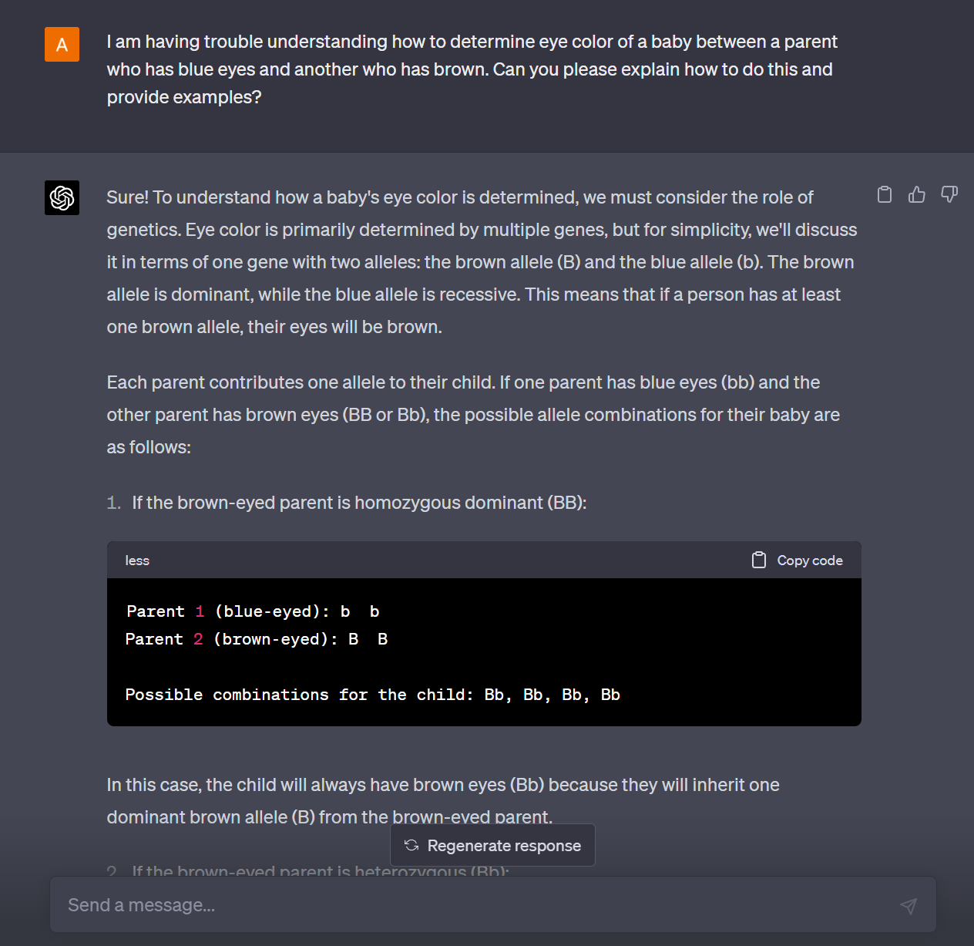
3. Personal Tutor
Ask it to generate practice questions and when completed, ask it to explain answers
ChatGPT can help simplify complex topics and provide examples
Offers real time feedback on work and can even encourage students on their hard work
Notes:
Answering Domain Questions
Provides domain-specific insights: ChatGPT can answer questions about specific industries, helping you make informed decisions in your data analysis.
Clarifies terminology: ChatGPT can explain domain-specific terms and jargon, improving your understanding of the subject matter.
Offers contextual guidance: ChatGPT can provide advice on how to approach data analysis in specific domains, considering industry-specific nuances and trends.
Shares case studies and best practices: ChatGPT can provide examples of successful data analysis projects in your domain, helping you learn from real-world experiences.

Slide 12
Cautions/Considerations

Slide 13
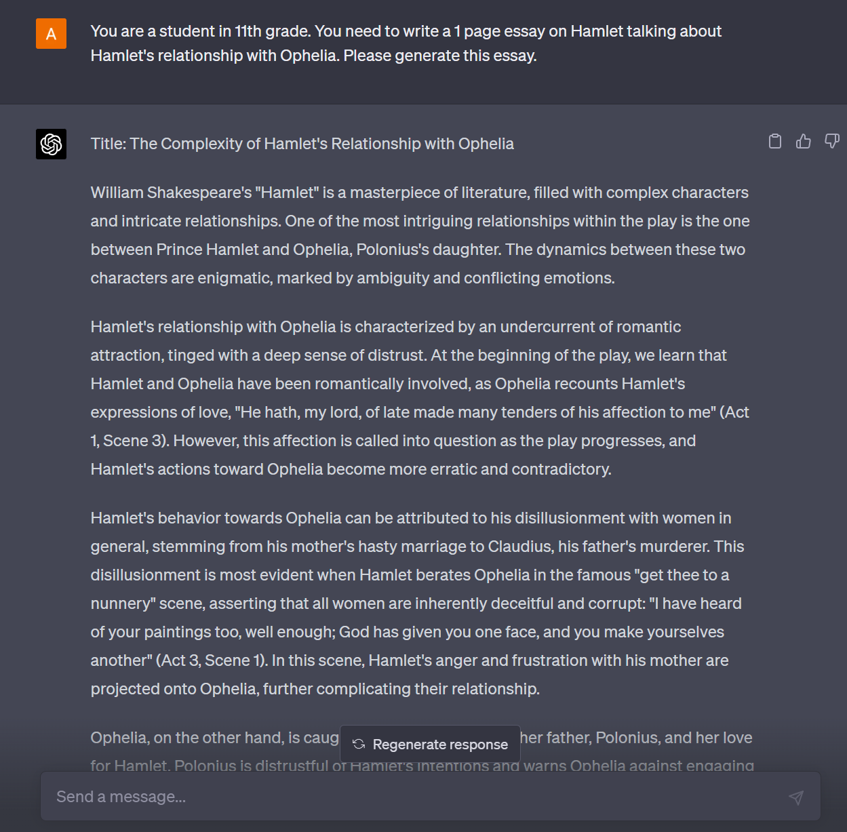
1. Plaigarism
ChatGPT can write extremely realistic
ChatGPT can help simplify complex topics and provide examples
Offers real time feedback on work and can even encourage students on their hard work
Notes:
Answering Domain Questions
Provides domain-specific insights: ChatGPT can answer questions about specific industries, helping you make informed decisions in your data analysis.
Clarifies terminology: ChatGPT can explain domain-specific terms and jargon, improving your understanding of the subject matter.
Offers contextual guidance: ChatGPT can provide advice on how to approach data analysis in specific domains, considering industry-specific nuances and trends.
Shares case studies and best practices: ChatGPT can provide examples of successful data analysis projects in your domain, helping you learn from real-world experiences.

Slide 14


2. Misformation
ChatGPT can write inaccurate or outdated information
Can provide information confidently which sounds believable, but is not correct
Notes:
Detects potential errors: ChatGPT can identify potential issues in your code and provide guidance on how to fix them.

Slide 15
Questions?

